Slide 1


Group member：
Junling Gao
Wenqing Liang
Tripti Santani
Ashish Kumar
Dipti Bhattad
Facebook

Slide 2
Fama-French 3 Factor
AR1
01
Models
02
Exponential
Moving Average
03
MACD
04
fbProphet
05
Support Vector Machine
06
Kalman Filter

Slide 3
NO.1
F-F & AR1

Slide 4
NO.1
F-F
Yt+1=Mkt-RF (t) + SMB(t) + HML (t) +ADS(t) + Percentage Change in Volume
beta_hat: [ 1.51993656e+02 1.25366576e-02 -6.75698435e-01 -3.05525737e+00 5.29167412e+01 -1.28690965e+00]
t_test: [ 1.50798981e+02 9.59203728e-03 -3.43638725e-01 -1.64249352e+00 1.60566019e+01 -5.02477264e-01]
p_val_t: [0.0, 0.9923496342306288, 0.7312258063716599, 0.1009569831720234, 0.0, 0.6154969494414058]
f_test: 6.480451452052192
p_val f_test: 6.785081437921114e-06
R2 and adj_R2: 0.2839158701495429 0.2785317789476598

Slide 5
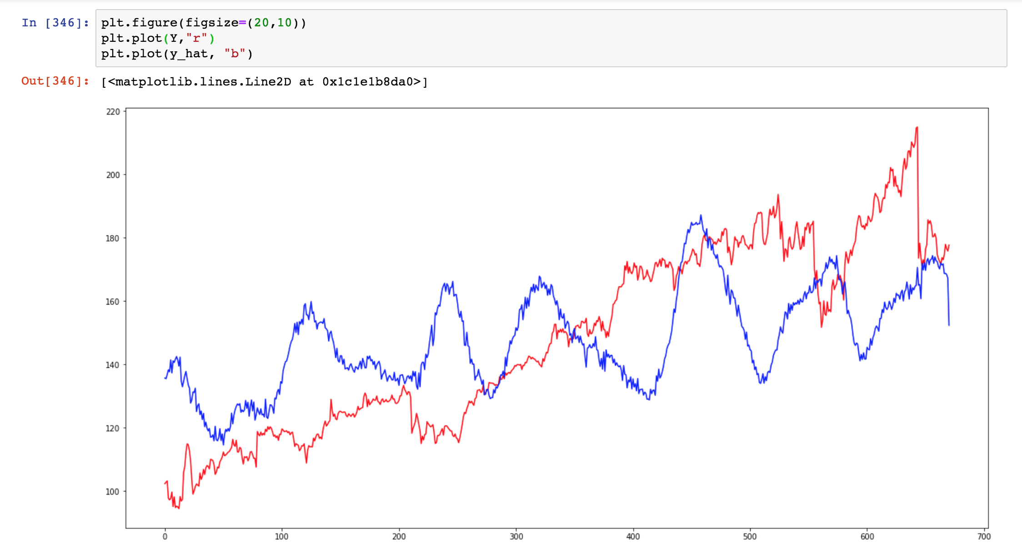
NO.1
F-F

Slide 6
NO.1
AR 1
Yt+1= Yt + [Open-Close]t + [High-Low]t +Volume(t) + ADS(t)
beta_hat:[ 3.97468545e-01 9.97408109e-01 -9.40087859e-01 9.92312838e-02-1.13826300e-06 5.84216810e-02]
t_test: [ 2.03954265e+00 8.21545691e+02 -8.94836520e+01 8.13056983e+00-4.46183473e+00 5.23482991e-01]
p_val t: [0.04178828109159505, 0.0, 0.0, 1.9984014443252818e-15, 9.532498746578355e-06, 0.6008115364530675]
f_test: 9835376.462412778
p_val f: 1.1102230246251565e-16
R2 and adj_R2: 0.999412364428967 0.9994079461164028

Slide 7
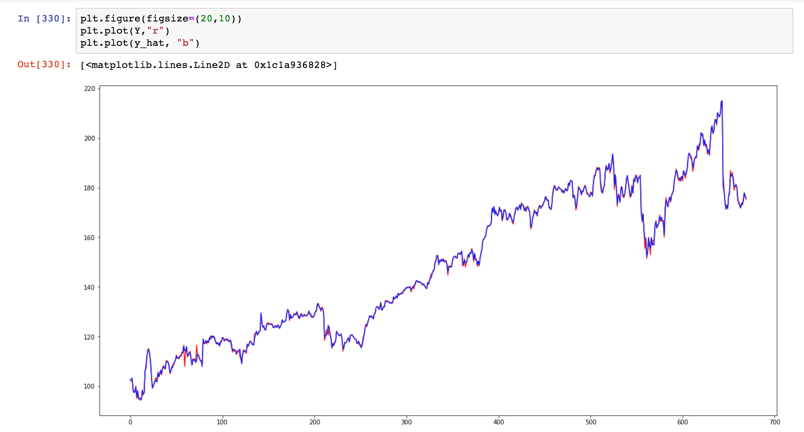
NO.1
AR 1

Slide 8
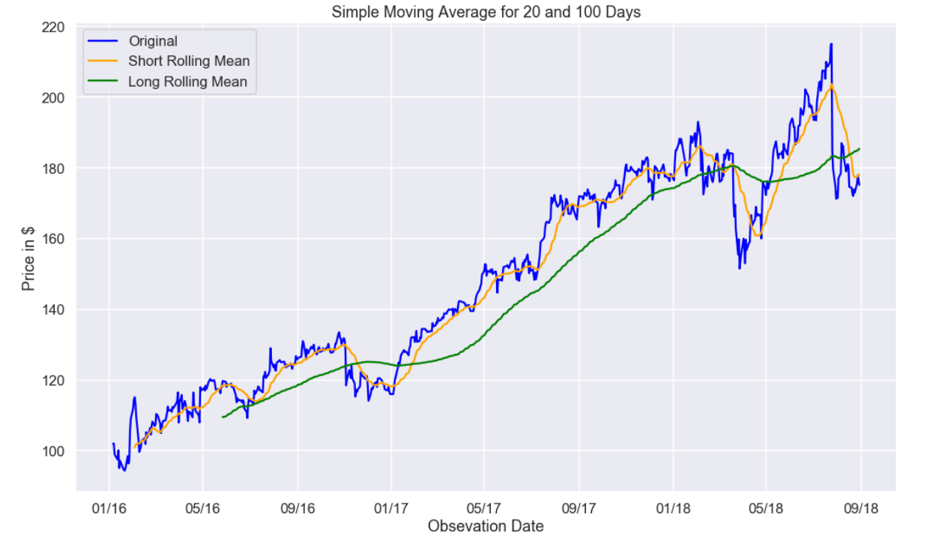
No. 2
Simple Moving Average
Simple Moving Average Strategy SMA is one of the simplest trading strategies. As the name implies this technique uses a rolling average of 'D' days and 'D-1' days are not taken into consideration as they are used for calculation. So, if we calculate a 5 days moving average the 1st 4 days value will not be considered.

Slide 9
No. 2
Simple Moving Average Demerit
Although the SMA curve is much more smoother and less noisy than the Actual Price, it has a huge demerit. The SMA curve has a lagging value than the original price timeseries. This lag (L) is actually equal to D/2 days where D is the window for the SMA. So, if the SMA window is of 100 days, then the lag is almost of 50 Days, which, does not benefit us.

Slide 10
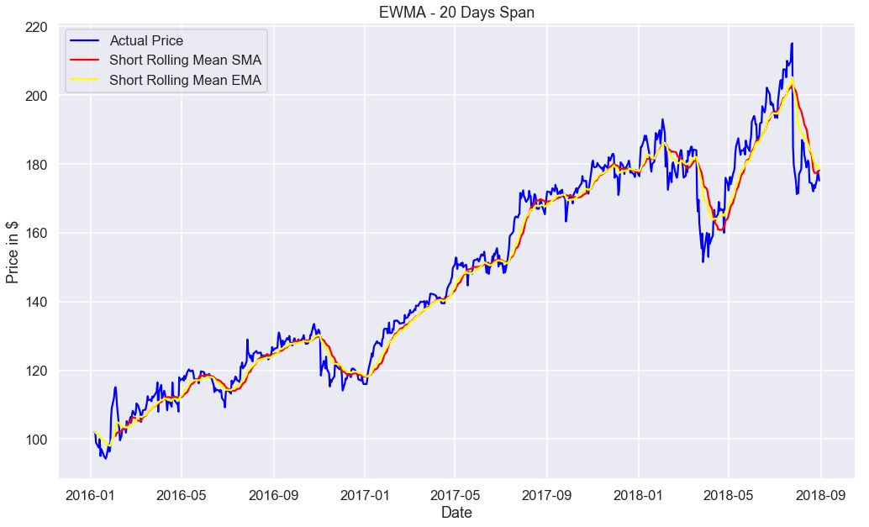
No. 2
Exponential Moving Average

Slide 11
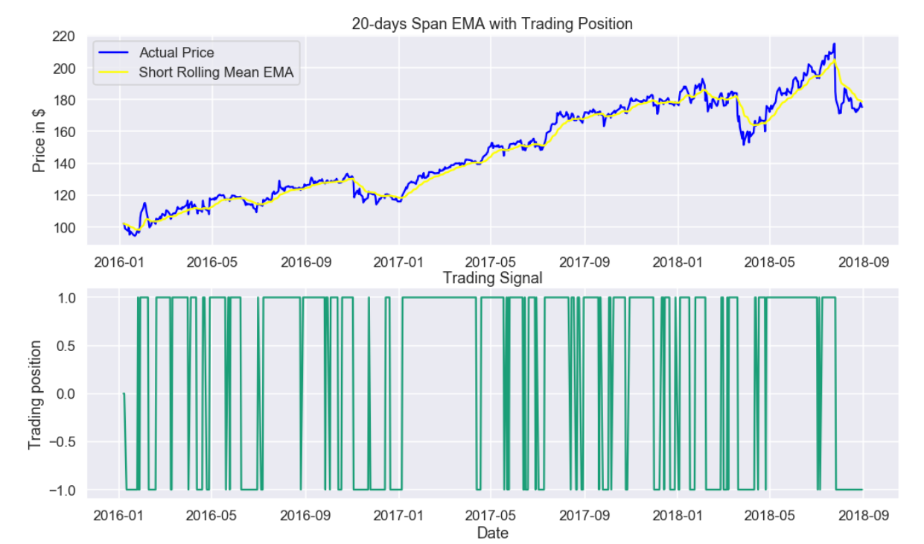
No. 2
Exponential Moving Average

Slide 12
No. 2
Linear Model
Yt=beta_hat0+beta_hat1*EMA(5)+ut_hat
beta_hat: [0.31200208 0.99937186]
t_test: [0.66375096 320.45974407]
p_val_t: [0.5070783847241129, 0.0]
f_test: 246966.0915409867
p_val f_test: 1.1102230246251565e-16
R2 and adj_R2: 0.9935469361780442 0.9935372903427349

Slide 13
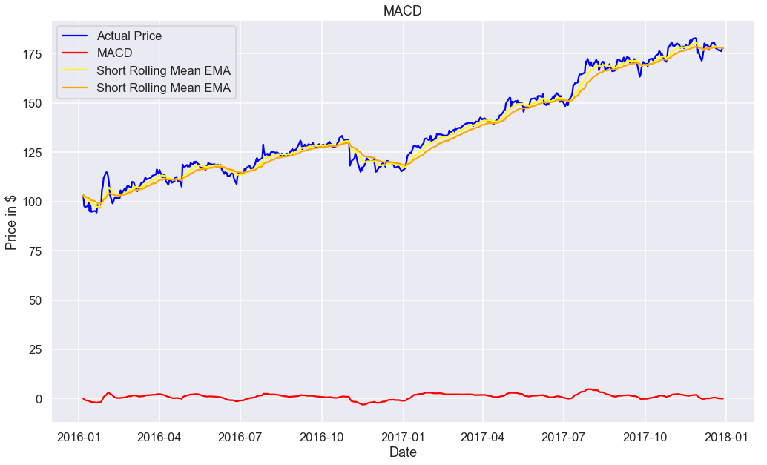
No. 3
MACD

Slide 14
No. 3
MACD
MACD=EMA_12-EMA_26
Yt=beta_hat0+beta_hat1*MACD+ut_hat
beta_hat: [130.20514192, 6.34232591]
t_test: [4.64227744, 0.39132399]
p_val_t: [1.72294867e-06, 3.47778883e-01]
f_test: 246966.0915409867
p_val f_test: 1.1102230246251565e-16
R2 and adj_R2: 0.1327984474205529 0.1310570788410761

Slide 15
No. 4
FB Prophet
Prophet is a time series forecasting technique developed by Facebook
Based on trend+seasonality+holidays
y(t)=g(t)+s(t)+h(t)+epsilon
Where g(t)=linear growth curve for modelling non periodic changes in time series
s(t)=periodic changes(eg. Weekly, yearly)
h(t)=effect of holidays with irregular schedules
epsilon=error term

Slide 16
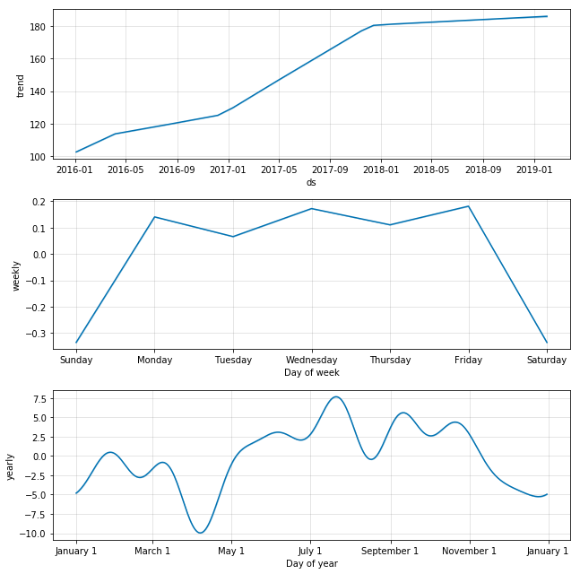
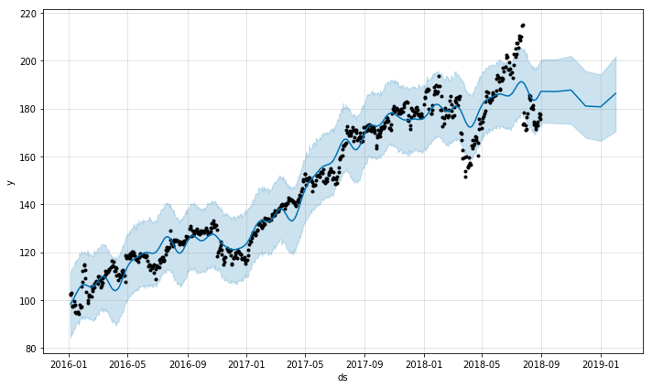
No.4
FB Prophet
R2: 0.9543450026962081

Slide 17
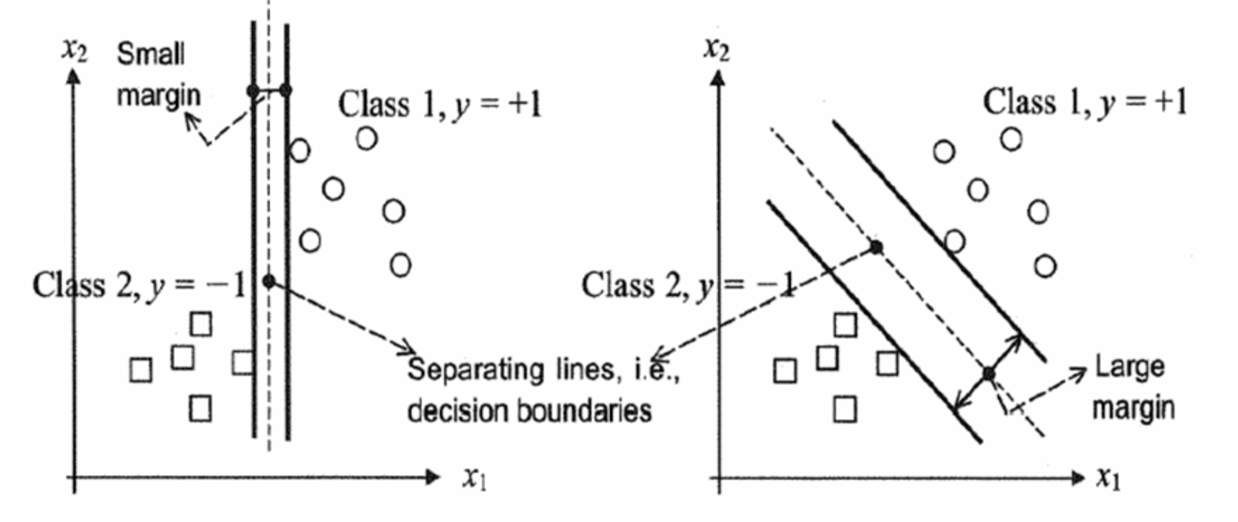
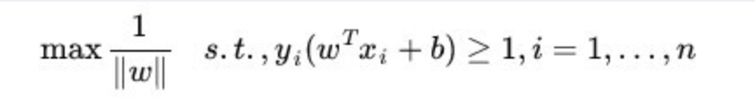
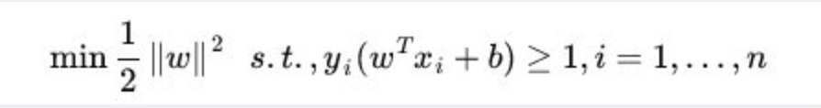
NO.5
SVM
For Classification

Slide 18
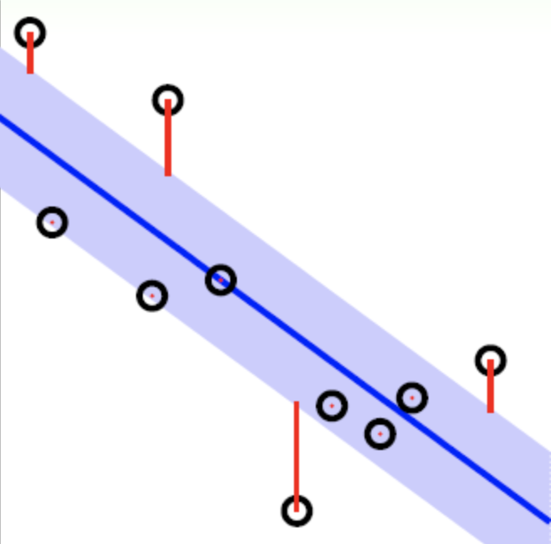
NO.5
SVM
For Regression
For SVM, the loss function is :
|yi−w∙ϕ(xi)−b| ≤ ϵ
Regression Line

Slide 19
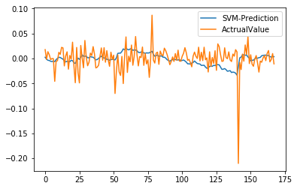
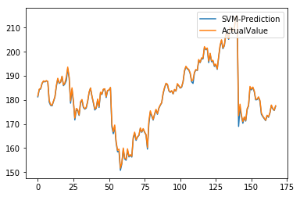
NO.5
SVM
Paras: Open, High, Low
Target: Daily Return Rate
Paras: Close Price Yesterday
, (High – Low)
Target: Open Price

Slide 20
NO.5
SVM - Evaluation
R2 = 0.9981317349570867;
Mean Squared Error = 0.305;
Mean Squared Error = 0.000686

Slide 21
NO.5
SVM - Selection
A
A
Randomly Pick Start Day from all 500 training day
B
B
Determine previous100 days as new training
C
C
Among these 100 days we use randomly pick 93 times period of time which its window size is 7 to test the model
D
D
Do 200 times for the Step A – C and each time we do the mean calculation

Slide 22
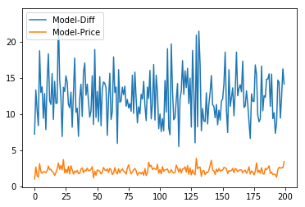
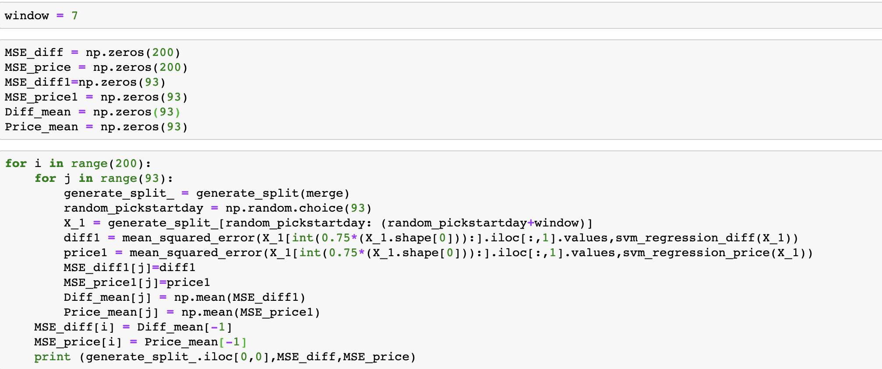
NO.5
SVM - Selection
Mean Model-Diff= 12.301790828768208
Mean Model-Price = 2.1700602069259904

Slide 23
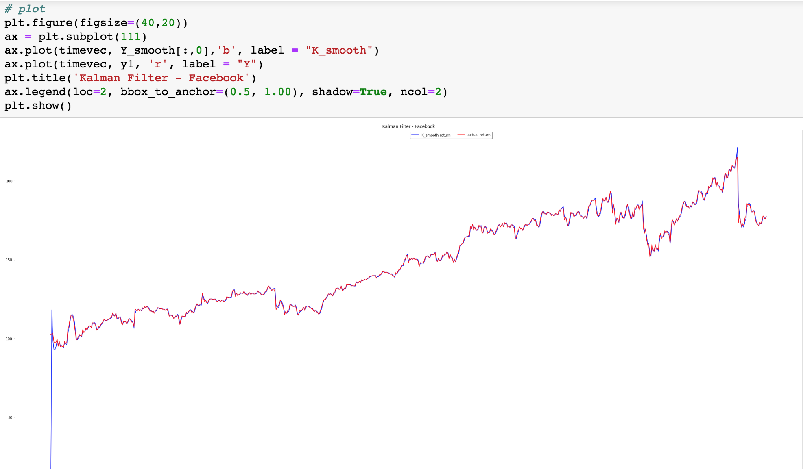
No. 6
Kalman Filter
R2: 0.9822244749544563

Slide 24
Bootstrap & Cross-Validation
-
Method
-
Performance

Slide 25
Method
Train: 620 CV: 50
For each day (t) in CV:
Y[t-200: t-1] → Bootstrap & Run Model
Predict Y[t] in each model
Calculate RMSE

Slide 26
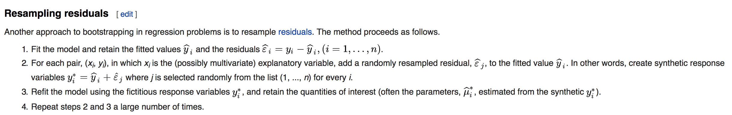
Method
Bootstrap Method: Resampling Residuals
Assumption: Residuals are independent and identically distributed (iid)
https://en.wikipedia.org/wiki/Bootstrapping_(statistics)

Slide 27
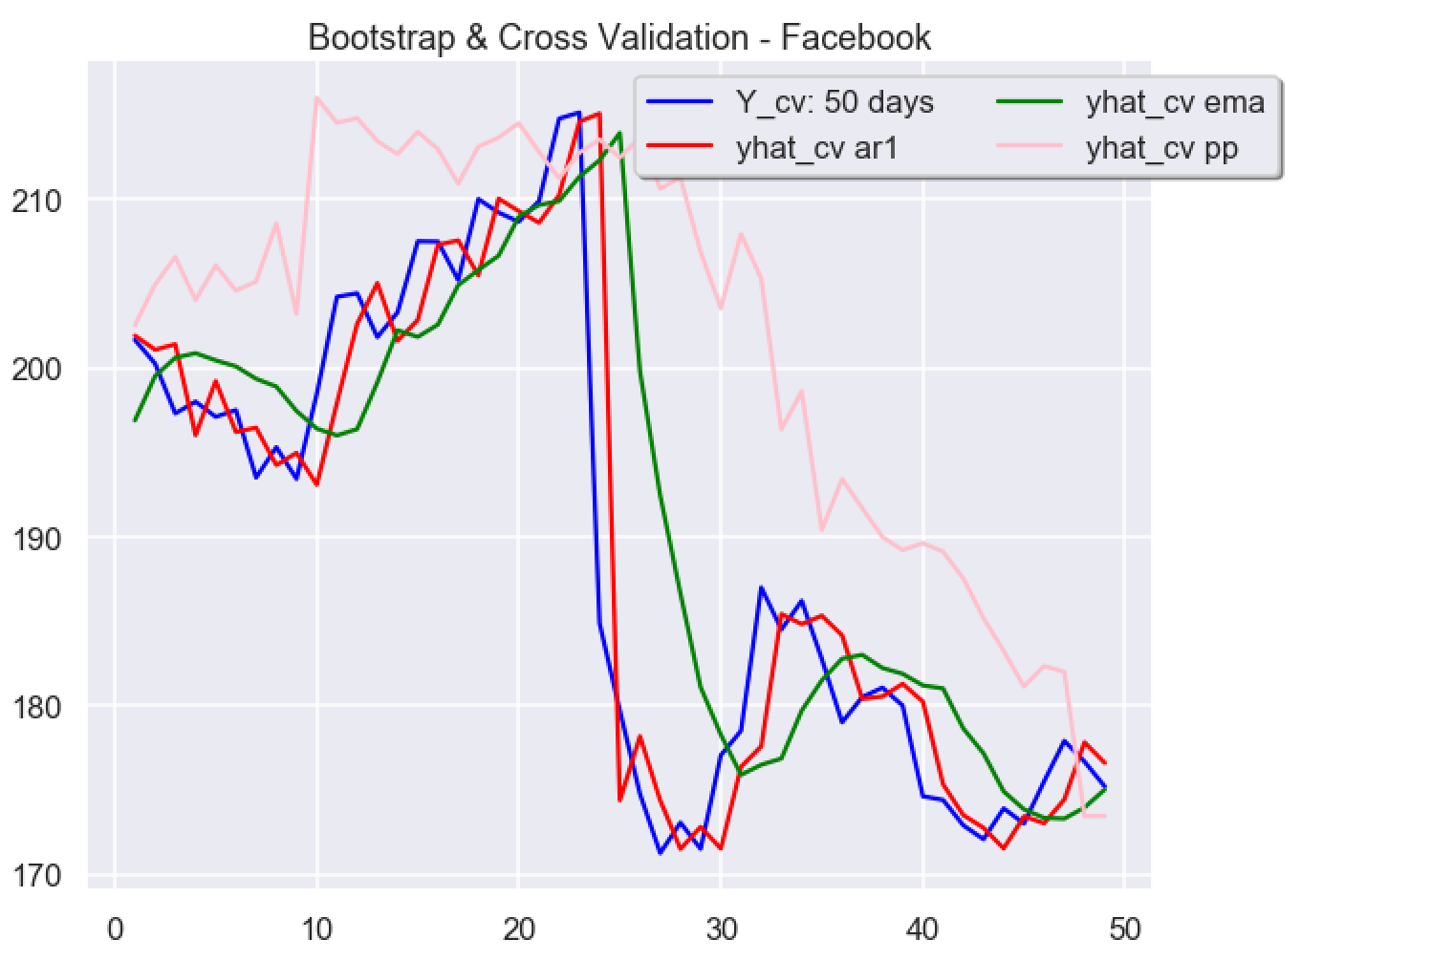
Performance
RMSE:
ar1_RMSE_cv:
5.320237121
ema_RMSE_cv: 9.158147524
pp_RMSE_cv 16.35246171

Slide 28
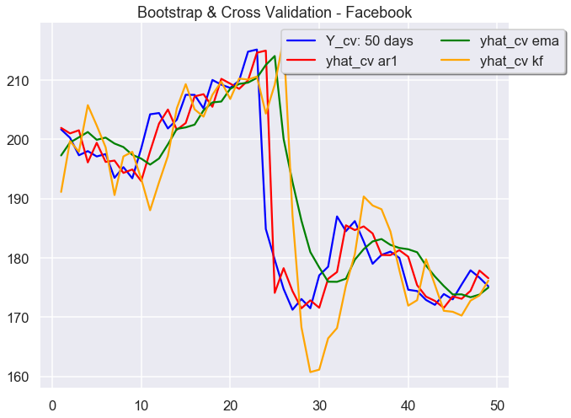
Performance
RMSE:
ar1_RMSE_cv: 5.3147133710050625
ema_RMSE_cv: 9.19614527536374
kf_RMSE_cv: 8.897850564624862

